Slide 1
Cautions about the Use of Bayesian Approaches For Design and
Analysis of Experiments
Geoff Vining
Virginia Tech

Slide 2
Overview
Scientific Method
Stages in Planning Experiments
Basic Issues
Where I See Promise
Where I Have Questions
Final Comments

Slide 3
Scientific Method
Scientific Method
  Iterative Process for Discovery/Problem Solving
  Involves Data/Data Analysis
The Study Cannot Be Biased!
Data Must Be Able to Stand on Themselves.

Slide 4
Stages in Planning Experiments
Define the Problem
Select the Responses
Determine Appropriate Factors
  Region of Operability
  Experimental Region
Identify Nuisance Factors
Define Tentative Model

Slide 5
Stages in Planning Experiments
Understand What Are Alternative Models
Choose the Design
Check for an Error of the Third Kind
Train People to Conduct the Experiment
Collect the Data
Analyze the Data in Light of the Actual Experiment Conducted

Slide 6
Basic Issues
Discovery versus Confirmation
  Box-Kiefer Debate
  Model Robustness versus “Model Is Correct”
Deming: Analytic versus Enumerative
Model Building versus Parameter Estimation
Difference
  Subject Matter Expertise and Insight
  Prior Belief

Slide 7
Basic Issues
All Experimental Designs Are Sequential
They Build upon Previous Experimentation
Subject Matter Expertise and Insight Are Essential
  Factors
  Experimental Region
  Tentative Model Structure
  Embrace “Informal Bayesian”

Slide 8
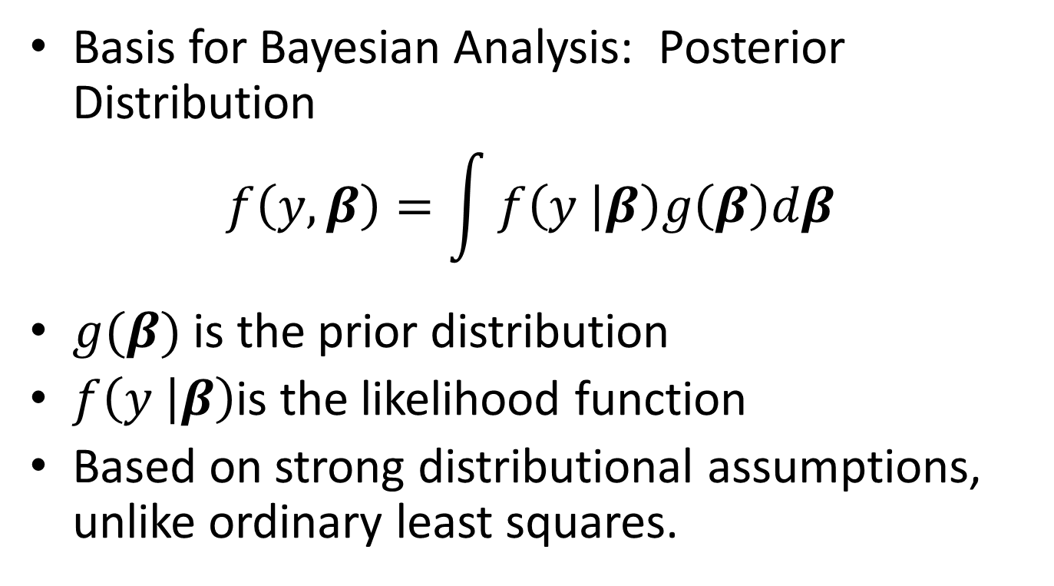
Basic Issues
Basis for Bayesian Analysis: Posterior Distribution
$$f\left(y,β\right)=\int{f\left(y | β\right)g\left(β\right)dβ}$$
$g(β)$ is the prior distribution
$f\left(y | β\right)$is the likelihood function
Based on strong distributional assumptions, unlike ordinary least squares.

Slide 9
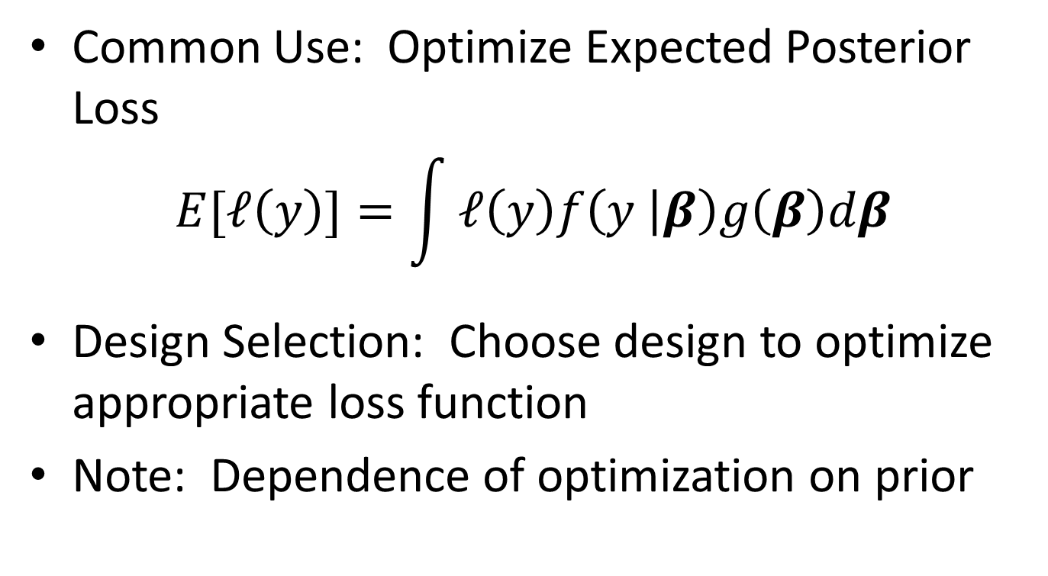
Basic Issues
Common Use: Optimize Expected Posterior Loss
$$E[ℓ\left(y\right)]=\int{ℓ\left(y\right)f\left(y | β\right)g\left(β\right)dβ}$$
Design Selection: Choose design to optimize appropriate loss function
Note: Dependence of optimization on prior

Slide 10
Basic Issues
Formal Bayesian Approaches Impart Bias
  Great if the Truth
    Can Speed the Investigation
  Problem: Never the Truth
  Issue: How Far from the Truth
    Essentially Correct – Typical Assumption
  Problem: Prior Can Dominate the Data
    Small Experiments
    Very Strong Priors
  Problem: Data no Longer Stand on Their Own

Slide 11
Basic Issues
Bias in the Design
  Not a Problem in “Standard” Experimental Design
  Problems Occur when the Variance/Covariance Matrix Depends upon Unknown Parameters
  Examples:
  Non-Linear Regression Models
  Generalized Linear Models
  Reliability Experiments
  Robust Parameter Design – Mean/Variance

Slide 12
Basic Issues
Non-Informative Prior
  Common Choice, Especially without Good Prior Information
  Really, No Gain from Use
  Comes with Cost: Much Stronger Assumptions
Strong Prior
  Requires a Great Deal of Prior Information
  Less Likely for the Data to Overwhelm Prior
  Worst Case Scenario: Point Prior

Slide 13
Where I See Promise
Nonlinear Regression: Pharmacokinetic Study
  Purpose is Confirmation
  Model Based on First Principals (Can Be Dangerous!)
  Single Factor
  The Points of Support for the Model Depend on the Parameters to Be Estimated
  Typical approach: Observational Study

Slide 14
Where I Have More Questions
Logistic Regression
  Model Justification: Taylor Series in Linear Predictor
  Model Robustness Questions
  Estimation Does Require Data at the Transition Point in the Probabilities
  More than One Factor
  Personally, Use Sequential Approach

Slide 15
Final Comments
Scientific Method
  Sequential Problem Solving Approach
  Ultimately, Data Must Stand on Their Own
Early Phases:
  Emphasis on Discovery
  Subject Matter Expertise Essential
  Formal Informative Priors Are Questionable

Slide 16
Final Comments
Where Can Informative Priors Play a Role
  Experiments Involving Systems of Systems
    Subsystems Are Well Understood
    The System of Subsystems Is Not
  Situations with Well Understood Fundamental Mechanisms with Good Insights from Other Experiments
  Final Stage Confirmation of the Model Produced from the Discovery Process

Slide 17
Final Comments
Need the Right Tool for the Right Job
Discovery is a Different World than Confirmation
Understanding the Experimental Context and Goals Are Essential for Success
Bayesian Tools/Approaches
  Can Be Valuable
  Must Use with Care

