Slide 1
Every Day Text Analytics
Mark Bailey SAS Institute Inc.

Slide 2
Are You a Text Analyst?
Have you
read a book and reviewed it?
researched a topic by selecting relevant papers, read them to learn about the subject, and summarized your findings?
read a lot of news stories and written a blog post about them?
read a lot of emails and assessed a situation?
Most of us have been analyzing text for most of our life.

Slide 3
What Is Text Analysis?
Text analysis is a process of parsing a sample of texts to find important terms, to group related texts, to group related terms, or to classify texts.
Text is data in the form of a written language.
Parsing is dividing one character string into smaller strings or terms.
Documents are samples of text available as a single string of characters.
Clusters are documents with similar patterns of terms.
Topics represent meaning found in shared terms.
Classify is assigning a document to one of two or more classes.

Slide 4
What is the Goal of Text Analysis?
The goal of text analysis is to convert a collection of unstructured texts into a set of structured quantities with identifiable patterns.

Slide 5
Caveat
Text analysis requires much attention and many subjective decisions by the subject matter expert to find important and meaningful patterns.
There is no guarantee that any or all of the meanings will be found.

Slide 6
Text as Data
Text data
occur as character strings (value)
values are related (for example, collection of accident reports)
values might be very small (for example, a sentence) or very large (for example, hundreds of pages) in size
have no units associated with any value
exhibit no order or organization within or between values
usually represent multiple topics with complex meanings
are ‘dirty’ and ‘messy’ (acronyms, abbreviations, misspellings, et cetera)
must be parsed using natural language processing.

Slide 7
Some Sources of Data
Email, text messages, social media
Newspapers, magazines, journals, blog posts
Stock reports, market news, patent filings
Field repair reports, accident reports
Survey comments
Patient health records, employee job descriptions
Product reviews, restaurant reviews, menus
Manufacturing: equipment logs, lot reports, control chart comments...
⇨ Import myriad file formats using common character encodings

Slide 8
Structured Data
Structured data occur as single values or levels.
Numeric values such as measurements, dates, or times.
3.14 grams, 17.76 liters
12May1820, 13Aug1910
Character strings represent values such as labels or levels to indicate groups or categories.
Poor, Acceptable, Average, Good, Very Good, Excellent
First Name, Last Name, Street, City, State, Country
Data such as these can be stored in myriad file formats or database tables.
Reading and writing such tables or files might require translation.

Slide 9
Document
Each data value is called a document regardless of the type of text or its source.
The value is one character string.
The value might be a single sentence, email message, or entire book.

Slide 10
Corpus
The corpus is the sample of text data to be analyzed.
More than one corpus is a corpora.
The corpus is a single variable (e.g., X or Y).

Slide 11
Token
A token is the result of splitting the character string (document) into smaller strings.
The string is split into tokens based on common delimiters and punctuation.
Delimiters are not retained in the token stream.

Slide 12
Term
A term is the basic unit of information in text analysis.
A term can be a single word or more than one word.
A modest corpus might produce thousands of terms of which only a small proportion will be worth analyzing.
Curating the term list might be the most important step in a successful text analysis.

Slide 13
Phrase
A phrase is a series of tokens that represent information together.
For example: monkey, bars ⇨ monkey bars
A phrase can be used as a term.

Slide 14
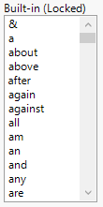
Stop Word
A stop word is a common word that usually is without inherent meaning.
Stop words are usually pre-defined (shown at right).
Tokens that are stop words are deleted from the term list and phrase list.

Slide 15
Recode
Different tokens might represent the same term.
For example: right | rite | rt | r. | r
Different tokens can be recoded to one instance.
For example: right | rite | rt | r. | r ⇨ right

Slide 16
Word Stems
Some tokens are related.
For example: run, ran, running
These tokens are all stems for the same term.
All these tokens can be stemmed to one term.
For example: run, ran, running ⇨ run•

Slide 17
Document Term Matrix
The information in the corpus is represented now as structured data in the document term matrix.
There is a row for each document in the corpus.
There is a column for each term in the current list.
The matrix contains the frequency of each term in each document.

Slide 18
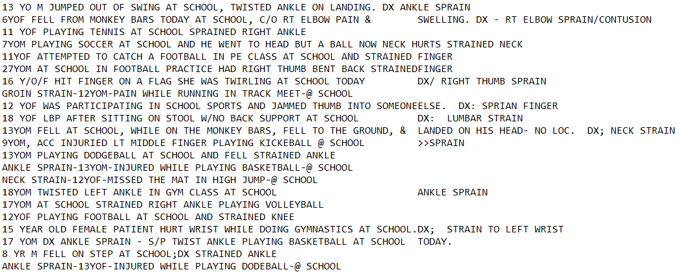
Analyze Narratives from the Emergency Room
From the National Electronic Injury Surveillance System of the United States Consumer Protection Safety Commission (CPSC) survey of 100 hospitals.

Slide 19
Considerations about Text Data
Consider the example of the descriptions captured in the emergency room.
The text was collected from 100 hospitals included in the survey.
Is there a standard or convention for text across all the hospitals?
Is the ER environment conducive to good data collection?
Many doctors work in the emergency room of each hospital.
Is record keeping their primary concern?
Are the entries made immediately and first hand, or later and second hand by someone who did not see the patients?
Are doctors capable of errors? (Wrong or omitted information, spelling or grammatical errors)

Slide 20
Workflow
Importing
Text analysis can be described as a general, linear workflow.
The results at one step, though, might lead to returning to a previous step for more work.
Tokenizing
Recoding
Terming
Phrasing
Exploring

Slide 21
Goals for Text Analysis
There are many possible questions that might be asked of the texts.
It is important to identify key questions before you begin.
They will guide your decisions at every step of text processing and analysis.
Here are some example questions:
What were the most frequent activities associated with accidents?
What were the most common injuries resulting from these accidents?
What parts of the body were injured in these activities?

Slide 22
Text Analysis Workflow: Tokenizing Stage
Importing
Convert text to tokens using basic words or regular expressions.
Select global parameters for tokenizing.
Customize regular expressions.
Decide about using numbers as tokens.
Tokenizing
Recoding
Terming
Phrasing
Exploring

Slide 23
Typical Tokenizing Decisions
Text analysis tools generally use tokenizing parameters that have a global impact on the term list.
They are easy to change but they are not selective.
Language used in the text
Minimum and maximum number of characters in terms
Maximum size and number of terms in phrases
Choice of parsing method
Choice of stemming

Slide 24
Tokenizing the Corpus
The corpus might be rich with information, but it is also complex and inconsistent.
Parsing with delimiters is simple and easy, but it creates a long, polluted term list.
Proper, precise tools are needed to handle real-world text data.
For example, Perl and Python are computer languages designed for text data.
Regular expressions are character strings that describe a target pattern.

Slide 25
Regular Expressions
Regular expressions describe patterns for tokens in the text.
Regular expressions were developed in mathematics to define a search pattern.
The syntax and grammar are simple, but complex strings can arise when dealing with complex and inconsistent patterns.
A succession of search patterns parse the text into tokens.
The order of these patterns can be changed.
The regular expressions can be added, removed, or modified as necessary.
The result returned for a pattern can be modified, formatted, or removed.
A regular expression may be used to extract targeted data, too.

Slide 26
Text Analysis Workflow: Recoding Stage
Importing
Recoding is the process of substituting one value for another value.
Most text operations are sensitive to case, spelling, tense, and form.
Recoding provides a way to establish consistency in the representation of some information.
Recoding also corrects various errors.
Changing order of terms is helpful to find related terms.
Tokenizing
Recoding
Terming
Phrasing
Exploring

Slide 27
Recode Example
The original tokens might inconsistently represent the same value.
The original tokens might exhibit misspellings or other errors.
Original | Recoded
m | m
M | m
MALE | m
Mail | m
F | f
FEMALE | f

Slide 28
Unique Tokens
Regular expressions are a good way to make tokens when there are only a few unique examples.
L.O.C, C.H.I are common abbreviations in the example corpus.
The tokens might otherwise be lost by one of the commonly applied built-in regular expressions, such as Words.
Decide whether it is valuable to target such tokens for retention or elimination.
Use recode instead of regular expressions when there are many such tokens. (This is discussed later in the chapter.)

Slide 29
Text Analysis Workflow: Terming Stage
Importing
Start the term list with all the available tokens that conform to the current tokenizing parameters and recoding rules.
Automatically eliminate common stop words.
Combine word stems for clarity.
Remove meaningless tokens as custom stop words.
Tokenizing
Recoding
Terming
Phrasing
Exploring

Slide 30
Stemming Terms
Stemming can reduce the complexity of the term list and improve the clarity of the text analysis.
Exceptions to stemming might be need, on an individual term basis.

Slide 31
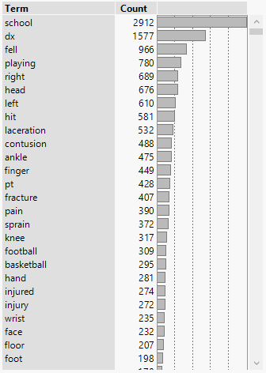
Examining the Terms
Order the current in descending frequency.
The most frequent and least frequent terms are usually the least important or informative.
The most frequent terms are in practically every document.
The least frequent terms are in practically no documents.
Consider the context by examining the original text.

Slide 32
Terming Is Fundamental to Text Analysis
The analyst must carefully choose parameters and terms.
The analyst can decide whether a result of an analysis is significant when statistical methods are available to test a hypothesis about structured data.
The analyst must instead use their expert judgment in text analysis to determine whether a term is important.
Subject matter experts are best at deciding the importance of terms.
Keep in mind the source of the text, the information content, and the goals of the analysis.
This stage is one of the most difficult and most time consuming, but it is also perhaps the most important to the success of the text analysis.
Do not strive for perfection. Strive for new information.
Do not worry about the small details. They are just that – small.

Slide 33
Text Analysis Workflow: Phrasing Stage
Importing
Create phrases from the current term list.
Identify phrases that could be useful and add them to the term list.
Tokenizing
Recoding
Terming
Phrasing
Exploring

Slide 34
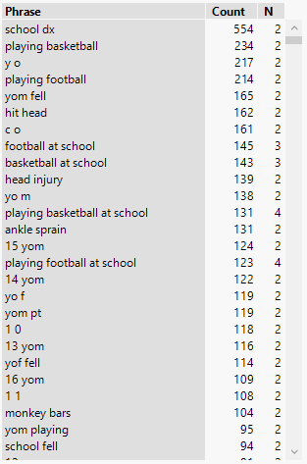
Meaning of Phrases
Order the current phrases in descending frequency.
The automated formation of phrases produces many nonsense phrases.
Some phrases can be meaningful.
Some meaningful phrases should be terms.
Consider the context by examining the original text.

Slide 35
Text Analysis Workflow: Exploring Stage
Importing
Explore the curated term list with a word cloud.
Save the document term matrix to explore with any other statistical analysis or visualization.
Apply transforms.
Tokenizing
Recoding
Terming
Phrasing
Exploring

Slide 36
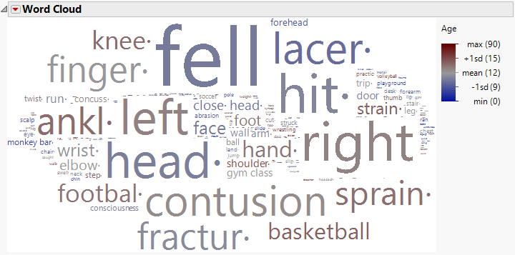
Text Analysis Workflow: Word Cloud
Examine the word cloud to extract meaning from the curated term list.
The size of each term is proportional to its frequency.
Color may be used to introduce an external variable (e.g., Age).

Slide 37
Text Analysis Workflow: Document Term Matrix
Make indicator variables for individual terms as new external variables.
Save the transformed document term matrix.

Slide 38
Saved Document Term Matrix
Structured data are the term frequencies in each document.
Could weighting or transforming the frequencies enhance the analysis?

Slide 39
Need for Weighting
The values in the document term matrix are the frequencies of each term in each document.
Weights can be used to vary the importance of terms.
Weighting is generally more important with large documents.
Weighting the frequencies can improve the analysis in some situations.
For example:
The variance in the frequencies might not provide additional information, so indicators might suffice.
Documents that vary widely in size skew the frequencies and can lead to large documents dominating the analysis.

Slide 40
Local Weights
A local weight is a transformation of the frequencies.
Local weights are also known as frequency weights.
Local weights provide insight into the composition of the documents.
Local weights include binary, ternary, and log frequency.

Slide 41
Global Weights
A global weight applies to a given term.
The weight is applied to all the frequencies for that term.
Global weights provide insight into the importance of a term.
A fundamental assumption of global weights is that the term is not present in many documents but occurs often when it is present.
Such terms are useful to discrimination of the documents, and global weighting can enhance the discrimination.

Slide 42
Term Weighting Options
Weighting options determine the value in the document term matrix.
Local transformations:
Binary: absent or present (default option)
Ternary: absent, present once, or present more than once
Log₁₀ Frequency
Global transformations:
Frequency (identity transform)
Term Frequency-Inverse Document Frequency (TF-IDF)

Slide 43
Binary Weights
Binary weights are local (transform local frequency).
Replace frequency with indicator:
0 indicates absent term
1 indicates present term
Binary weights provide the maximum simplification of the document term matrix for understanding the composition of the documents.
Binary weights are good for some plots or for categorical predictors.

Slide 44
Ternary Weights
Ternary weights are local (transform local frequency).
Replace frequency with indicator:
0 indicates absent term
1 indicates present term, one occurrence
2 indicates present term, two or more occurrences
Ternary weights provide some simplification of the document term matrix for understanding the composition of the documents.
Ternary weights are good for some plots or for categorical predictors.

Slide 45
Log Frequency Weights
Log frequency weights are local (transform local frequency).
Replace term frequency, , with .
Log Frequency is highly recommended.
It is useful for avoiding some documents dominating the analysis when there is excessive skewing of the frequencies.

Slide 46
Frequency Weights
Frequency weights are global (weight all frequencies of a term).
The weight is always 1, so the value is just the term frequency.
Frequency weights retain the original information to help determine the relative importance of each term.

Slide 47
TF-IDF Weights
TF-IDF weights are global (weight all frequencies of a term).
This weighting considers the document frequency.
The weight for the i^{th} term, w_{i}, is the logarithm, base 10, of the ratio of the number of documents, n, to the number of documents with this term, dfi.
The importance of a term (weight) is inversely proportional to its frequency.
Unusual terms are up-weighted if it occurs frequently in a document.
Achieves a type of centering for terms with different frequencies that approximates the principal component analysis on correlations.

Slide 48
Optimal Weighting
The decision about the weighting option is based on the empirical performance of the subsequent analysis.
More than one weighting option can be tried for the best results.

Slide 49
Thank you!

Slide 50
Appendix: Regular Expressions
Additional coverage of regular expressions follows.
There was not enough time to present it but it was kept in the hand-out.

Slide 51
Regular Expressions
Regular expressions consist of characters and meta-characters.
Meta-characters use a special character or an escape sequence to be recognized.
Expressions are read from left to right.
The source text is processed from beginning to end and the matches are greedy.
Patterns might be literal (for example, particular word) or variable (for example, any telephone number).
It is better to be as specific as possible and minimize the use of wildcard characters.

Slide 52
A Few Meta-Characters in Regular Expressions
"That was fun, that was!"
Meta-Character | Regular Expression | Result
(none) | "were" | .
(none) | "was" | "was"
. (any character) | ".un" | "fun"
\s (whitespace character) | "\swas\s" | " was "
\S (not whitespace character) | "\S" | "T"
\w (any word character) | "\w" | "T"
\W (not word character) | "\W" | " "
(whitespace characters are a space, tab, return, new line, vertical tab, or formfeed)
(word characters are “a” to “z”, “A” to “Z”, and “0” to “9”)

Slide 53
A Few Special Characters in Regular Expressions
"That was fun, that was!"
Meta-Character | Regular Expression | Result
? (optional instance) | "\w?" | "T"
* (any number of instances) | "\w*un" | "fun"
+ (one or more instances) | ".+as\s" | "That was "
| (alternatives) | "was|were" | "was"
[] (character set, optional “-”) | "[.?!]" | "!"
() (sub-expression) | "(\w+)\s(\w+)" | "That was"
^ (negate) | "[^A-Z]" | "h"
^ (anchor at beginning) | "^[A-Z]" | "T"
$ (anchor at end) | "\S$" | "!"

Slide 54
Regular Expressions Are Greedy
Regular expressions match as much of the pattern as possible.
Regular expressions are greedy.
This behavior might produce unexpected results.
For example, if there is more than one match, it is likely that the first match is not the one that is returned.
It is possible to use the reluctant or lazy operator, ?, to force the regular expression to match as little as possible.
Consult one of the sources given in the appendix for more details.

Slide 55
Regular Expressions for Location
Regular expressions match a pattern and return it.
Sometimes the presence of a part of a pattern is important for the match, but that part should not be returned as part of the match.
For example, you might have to define a pattern for an entire telephone number even if you want only the area code.
Special operators can be used to look ahead or look behind in the negative or positive direction.
Consult one of the sources given in the appendix for more details.

Slide 56
JMP Regex() Function
JMP provides several functions that apply regular expressions to text.
Regex(), Regex Match(), Pat Regex()
The examples of regular expressions that follow use Regex().
The source is the text to be searched.
The regex is the pattern to be found.
The optional format can be used to customize the result returned.
Regex( source, regex,
<format, <IGNORECASE>, <GLOBALREPLACE>> );

Slide 57
Back References
Sub-expressions make one or more capturing groups of patterns.
These sub-expressions in the text can be referred to with back references.
They are referred to by number as "\n" in new expressions.
The n is a 1-based index into the array of capturing group results.
"\0" is the entire result of the match and the default back reference.
Regex( "That was fun, that was!",
"(\w+\s)(was|is)(.+),(.+)([.?!]$)",
"\1could be\3\5"
);
"That could be fun!"

Slide 58
Break It Down
That_ | was | _fun | , | _that_was | !
(\w+\s) | (was|is) | (.+) | , | (.+) | ([.?!]$)
Regex( "That was fun, that was!",
"(\w+\s)(was|is)(.+),(.+)([.?!]$)",
"\1could be\3\5"
);
"That could be fun!"

Slide 59
Extract Targeted Information for Structured Data
The text can be searched for specific information and extract it.
This technique can be used to create new structured data variables.
In this example, email messages are scanned for credit card numbers.
(Note: The {4} are special characters indicating repetition.)
Regex(
"I really want the iCar!
Here is my credit card number,
1234-5678-9012-3456.",
"\d{4}-?\d{4}-?\d{4}-?\d{4}"
);
"1234-5678-9012-3456"

Slide 60
Target Extraction for Structured Data
In this example, the text is scanned for an email address.
Regex(
"Please send your quotation and references to me at jane.smith@jmp.com. Thank you!",
"\b[a-zA-Z0-9._%+\-]+@[a-zA-Z0-9.\-]+\.[a-zA-Z]{2,}\b"
);
"jane.smith@jmp.com"

Slide 61
Age and Gender in Text
The example text usually includes the age and gender of the patient.
This information might not be useful in the term list.
It might be valuable as covariates, though, if it could be extracted.
This information, however, occurs in many forms. For example:
"5 YO MALE, 10 YO F, 6 Y/O/M, 8YOF, 5YOF, 14YOWM, 6 Y/O B/M, 35 YR OLD MALE, 17 M, 6 YR OLD BLACK MALE"
(Note that this list does not include all of the patterns found in the example.)

Slide 62
New Age and Gender Variables
Extract the age and gender in most cases where it exists in the corpus.
For example:
Regex(
:Text[15],
"(\d\d?)\s*(YEAR|YR|Y)?(\s|/)?(OLD|O)?
(\s|/)?(BLACK|B|WHITE|W)?(\s*)(M|F)",
"age = \1, gender = \8"
);
"age = 4, gender = M"

Slide 63
Regular Expressions in Text Explorer
Many regular expressions are provided in the Regex Library.
Add the ones that help with a particular corpus.
Remove or modify any of them as needed, too.
Write custom expressions for unique tokens.
Remember that the text is converted to lowercase before tokenizing, so it is best to write regular expressions that match lowercase targets.

