Slide 1
Generalized Linear Models with Regularization

Slide 2
Outline
Regression and Generalized Linear Models
Regularization with (Lasso) and (Ridge)
Numerical Optimizers
Workload Performance Analysis
Questions and Answers

Slide 3
Large-Scale Predictions: Generalized Linear Models with Regularization
    Applications in Finance, Retail, Banking, Bioinformatics, Manufacturing, Services,…

Slide 4
Problem Statement
Too many Independent variables result in large variances and model interpretation:
  There is a need to reduce the number of Independent variables
  LASSO Regression ( -Regularization)
Correlated Independent variables produce spurious results & cause computational difficulties:
  There is a need to control effects of correlation(multicollinearity) among the independent variables
  Ridge Regression ( -Regularization)
Need a model that is General, Accurate, Scalable, and Interpretable

Slide 5
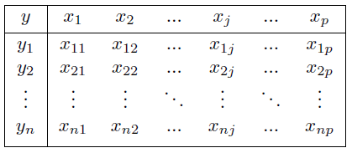

Linear Regression
The standard data layout for GLM is a table:
The goal is to develop an equation of the form
where each term is the coefficient for the corresponding column of x-values.
The equation resulting from estimation by ordinary least squares (OLS) then be used to predict an individual’s y-value given the corresponding x-values.

Slide 6


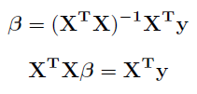
Linear Regression
The epsilon term represents the residual or error term. To find the optimal values, we aim to minimize the sum of squared residuals, which is equal to
We can find that the solution is given by
When the number of independent variables is large, gradient descent optimization is applied

Slide 7
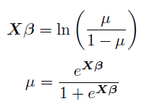
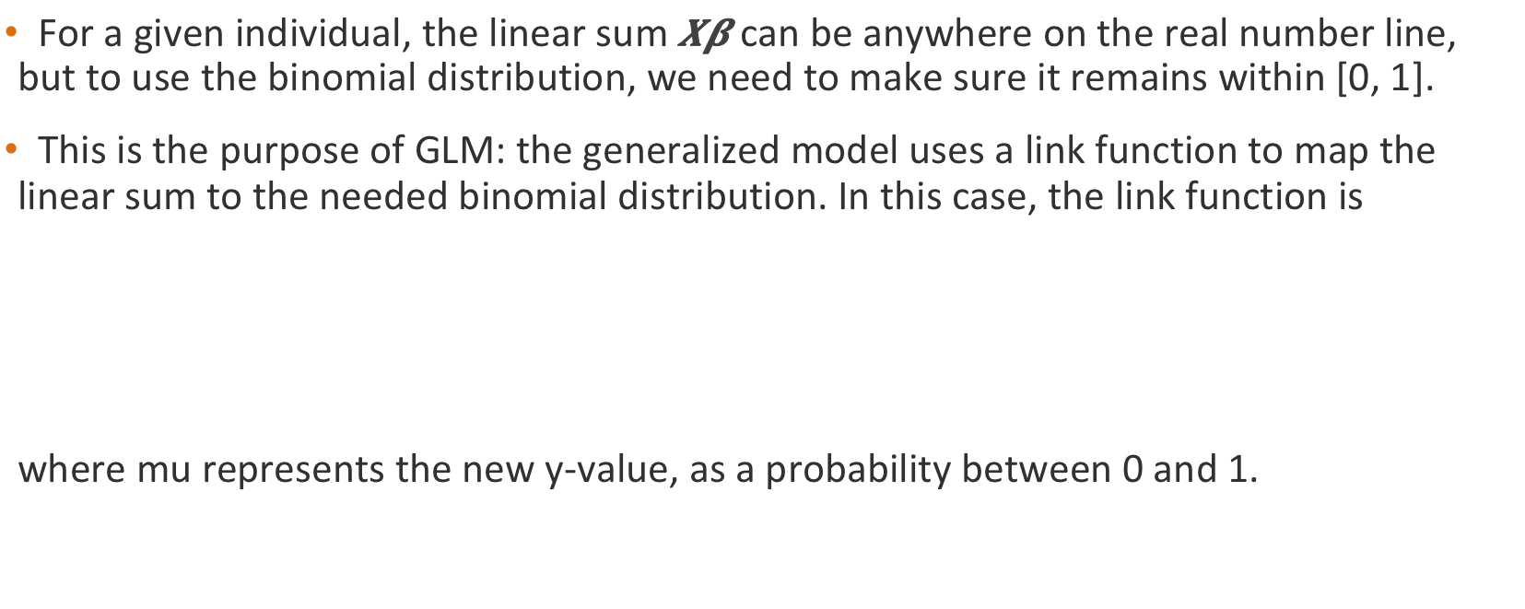
Logistic Regression
For a given individual, the linear sum $Xβ$ can be anywhere on the real number line, but to use the binomial distribution, we need to make sure it remains within [0, 1].
This is the purpose of GLM: the generalized model uses a link function to map the linear sum to the needed binomial distribution. In this case, the link function is
where mu represents the new y-value, as a probability between 0 and 1.
Where μ represents the probability of Y=1

Slide 8



Logistic Regression
Unlike linear regression, there is no closed-form analytical solution for logistic regression, so we instead use an iterative numerical method for maximum likelihood estimation, with the likelihood function
For simplification purposes, we take the logarithm of this function to make it a log-likelihood function, and perform some other algebraic steps, resulting in

Slide 9
Regularization
In many settings, the number of observations (n) is much larger than the number of variables (p), meaning that n >> p.
However, in real-world applications, it often happens that there are not many observations available, resulting in n ≈ p or even n < p.
  When this happens, it can improve performance to remove some of the independent variables, since there are so many that some of them become redundant.
  In this case, the LASSO method is best, based on regularization.
It is also common that the independent variables are closely correlated with each other, meaning that they have a high level of collinearity.
  When this happens, it can improve performance to decrease the overall size or effect of the independent variables, avoiding overfitting.
  In this case, the ridge method is best, based on regularization.

Slide 10



Regularization
For LASSO regression, instead of minimizing just the sum of squared residuals, we add a penalty term, which encourages smaller values for the beta coefficients.
This is equivalent to minimizing the original sum of squared residuals, but under a constraint, where t is an input parameter that determines the level of regularization.
Ridge regression works in a similar way, but the penalty term is squared and not linear.
such that

Slide 12

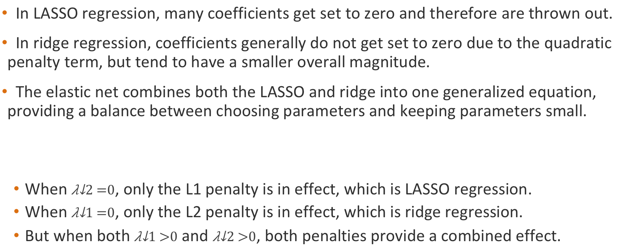
Elastic Net Regularization
In LASSO regression, many coefficients get set to zero and therefore are thrown out.
In ridge regression, coefficients generally do not get set to zero due to the quadratic penalty term, but tend to have a smaller overall magnitude.
The elastic net combines both the LASSO and ridge into one generalized equation, providing a balance between choosing parameters and keeping parameters small.
  When $λ_{2}=0$, only the L1 penalty is in effect, which is LASSO regression.
  When $λ_{1}=0$, only the L2 penalty is in effect, which is ridge regression.
  But when both $λ_{1}>0$ and $λ_{2}>0$, both penalties provide a combined effect.

Slide 13
GLM Models with Regularization (Gaussian and Binomial)
Generalized Linear Model
Used for prediction (Revenue, Profit)
Linear Regression
Gaussian
Logistic Regression
Binomial
Used for classification (fraud, conversion)

Slide 14
Computational Demand!
Building Large-Scale Predictive models with regularization is computationally intensive
Computational Performance is achieved by:
  Parallelization
  Enhanced machine learning algorithms
  State of the art math libraries (utilizing In-memory, GPUs …)

Slide 15
Optimization Algorithms
Gradient Descent
Batch Method
Searches for minimum along direction of the gradient by a line search
Updates after each scan of training data
Slow Convergence
Limited Memory-BFGS
Batch Method
Quasi-Newton method
Uses more information about the data (curvature, 2nd Derivative)
Stores only recent updates
Fast convergence
Stochastic Gradient Method
Non/Mini-Batch Method
First-order method which samples rows randomly from training
Fast convergence
Surprisingly quite accurate!

Slide 16
Optimization Algorithms
Stochastic Gradient Descent
Based on first derivative
Large number of short iterations
BFGS
Quasi-Newtonian (2nd derivative)
Small number of long iterations

Slide 17

Numerical Optimizers
Recall that we use a numerical iterative method with the log-likelihood function
More specifically, we generally use the Newton-Raphson method to perform an iteratively reweighted least-squares (IRLS) technique, where the vector of beta coefficients is updated at each step to equal
However, directly using this equation is computationally expensive, since it requires the exact calculation of both the gradient vector and the Hessian matrix at each step. As a result, “quasi-Newton” methods are used to simplify the calculation.

Slide 18
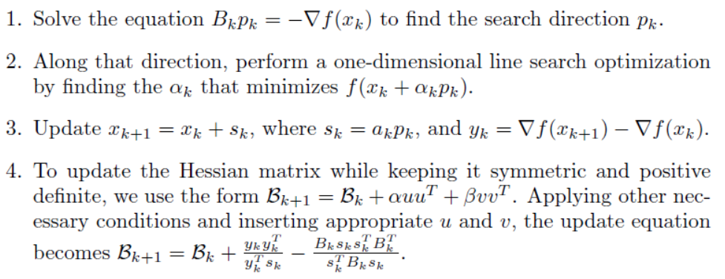
Numerical Optimizers
Examples include SGD (stochastic gradient descent) and FISTA (fast interactive shrinkage-thresholding algorithm). The most common algorithm, used by Teradata (along with MATLAB and R), is BFGS (Broyden-Fletcher-Goldfarb-Shanno).
  This algorithm does not calculate the entire Hessian matrix at each step, but instead maintains one approximate Hessian matrix in memory and continually updates it.
  The iterative process
  at each step k is:

Slide 19
Computational Quality Analysis
The implementation of elastic net in R is generally considered a baseline industry standard, since it was written by Trevor Hastie, Robert Tibshirani, and Jerome Friedman, the original creators of the method.
As a result, when testing the quality of our elastic net function, we benchmark it against R using certain accuracy metrics.
  Linear regression: mean absolute percentage error
  Logistic regression: accuracy, precision, recall, F-measure
The datasets used on the next slides have 100,000 rows and 100 columns, and were synthetically generated in Python to have ill-conditions such as high multicollinearity.
  To better mimic industry applications, further testing uses datasets with 10 million rows and 1000 columns, then goes on to even larger sizes after that.

Slide 20
Computational Results
Linear Regression (high-collinearity)
Data Size: 100,000 x 100

Slide 21
Computational results
Logistic Regression (binary)
High Collinearity
Data size: 100,000 x 100

Slide 22
SGD Parallelization
Synchronized SGD iterations
  Cluster level iterations
  Requires larger Mini-batch size to reduce #iterations
  Low performance
Independent workers approach
  Each worker perform SGD on random partition of the data
  Global SGD model combined from workers models
    Bagging: Average model = Average model parameters
    Model combiners
  Superior performance
  Estimate of quality of model combination measurable

Slide 23
Computational Enhancements
In-memory Utilization
  Function utilizes new distributed In-Memory structures for repeated iterations
    Teradata Aster In-memory Distributed Collections & Analytic Tables (#641)
  Super fast for small and sample data sizes (10X)
  Improvement for large data set. Optimized spill on demand.
GPU Readiness
  Computationally heavy operations (Matrix operations) in modules
  Modules can run equivalently on CPU or GPU
  Utilize vendor optimized math libraries

