Slide 1
Power-Grid Controller Anomaly Detection with Deep Temporal Models
Presented by Aswin Raghavan¹
Joint work w/ interns Zecheng He², Tharindu Mathew³
Sek Chai¹, Ruby Lee², Mohamed Amer¹
¹SRI International (Princeton) + ²Princeton University + ³Purdue University
Funded by NSF Resilient Computing and DARPA RADICS programs

Slide 2
Outline
Broad goal: Provide process monitoring, quality control and analytics at the hardware level. Why?
Activity Recognition: “GPU Activity Prediction using Representation Learning”, Aswin Raghavan, Mohamed Amer, David Zhang, Sek Chai, ICML 2016
Performance Optimization: “Event Prediction in Processors Using Deep Temporal Models”, Tharindu Mathew, Aswin Raghavan, Sek Chai, ASPLOS 2018
Malware detection / Code integrity: “Detecting Zero-day Controller Hijacking Attacks on the Power-Grid with Deep Learning”, Zecheng He, Aswin Raghavan, Sek Chai, Ruby Lee, TrustCom 2019
Source code → Runtime → Data
Modelling: Deep Temporal Generative Models
Application: Proactive computing for operational efficiency (GPU)
Application: Detecting zero day attacks on power grid controller code (PLC)
Discussion: Applications and Shortcomings

Slide 3
Hardware Performance Counters (HPC)
High-level lang.
program
Machine language in Instruction Set
ADD, COMPARE, IN, JUMP, LOAD, STORE, OUT
Micro-architecture is the way a given instruction set architecture (ISA) is implemented in a particular processor
Hardware Performance Counters (HPCs) are hardware units that count micro-architectural events
Set of special-purpose registers to store the counts of hardware-related activities
Pros/Cons of HPC: Lots of criticism surrounding use of HPC (more on this later)
Compiler
Assembly language
program
Assembler
Machine language
program
Binary form executable version
of program.

Slide 4
HPCs encode Activities (What’s new about using HPC?)
Core-1
Core-2
HPCs used for
Adaptive CPU scheduling
Performance monitoring
Debugging
Workload pattern identification
Only keep instruction type
Discard operands, memory etc.
t=240, {ld:8} --- load
t=250, {mov:2, mul:3} --- compute
t=260, {add:10, ld:2} --- compute
t=270, {st:10} --- store
Temporally extended events
Predictable
Events – higher order effects
Unique: Deep Temporal – data-driven learning of temporal features
Unique: Generative – predict future frames conditioned on history
Core-3
Core-4
Histogram of instructions e.g. in 61 dimensions

Slide 5
Outline
Broad goal: Provide process monitoring, quality control and analytics at the hardware level. Why?
Activity Recognition: “GPU Activity Prediction using Representation Learning”, Aswin Raghavan, Mohamed Amer, David Zhang, Sek Chai, ICML 2016
Performance Optimization: “Event Prediction in Processors Using Deep Temporal Models”, Tharindu Mathew, Aswin Raghavan, Sek Chai, ASPLOS 2018
Malware detection / Code integrity: “Detecting Zero-day Controller Hijacking Attacks on the Power-Grid with Deep Learning”, Zecheng He, Aswin Raghavan, Sek Chai, Ruby Lee, TrustCom 2019
Source code → Runtime → Execution analytics
Modelling: Deep Temporal Generative Models
Application: Proactive computing for operational efficiency (GPU)
Application: Detecting zero day attacks on power grid controller code (PLC)
Discussion: Applications and Shortcomings

Slide 6
Energy based models
Gibbs distribution

Slide 7
Mean

Slide 8
MRF

Slide 9
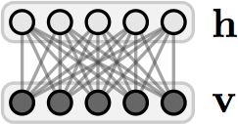
Restricted Boltzmann Machines (RBM)
RBM

Slide 10
Restricted Boltzmann Machines
The effect of the latent variables can be appreciated by considering the marginal distribution over the visible units:

Slide 11
Restricted Boltzmann Machines
In fact, the hidden units can be summed out analytically. The energy of this marginal distribution is given by:
where

Slide 12
RBM learning
Stochastic gradient descent
Maximize with respect to

Slide 13
RBM learning
Contrastive divergence
Getting an unbiased sample of the second term, however is very difficult. It can be done by starting at any random state of the visible units and performing Gibbs sampling for a very long time. Instead:

Slide 14
RBM inference
Block-Gibbs MCMC

Slide 15
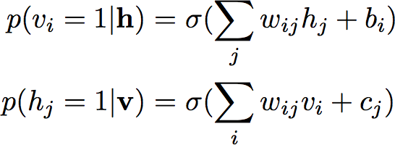
Sampling
All hidden units are conditionally independent given the visible units and vice versa.

Slide 16
Restricted Boltzmann Machine (RBM)
Boltzmann machine: E(x,h)=b' x+c' h+h' Wx+x’Ux+h’Vh
Undirected, loopy, layer
E(x,h)=b' x+c' h+h' Wx
h₁
h₂
h₃
h₄
h₅
partition function
x₁
x₂
x₃
h
W
x
P(x_{j} = 1|h) = σ(b_{j} +W’_{• j} · h)
Read the manuscript for details
P(h_{i} = 1|x) = σ(c_{i} +W_{i} · · x)

Slide 17
Restricted Boltzmann Machine (RBM)
E(x,h)=b' x+c' h+h' Wx
x = [x₁ x₂ …]^{T}, h = [h₁ h₂ …]^{T}
Parameter learning
Maximum Log-Likelihood
Geoffrey E. Hinton, “Training Products of Experts by Minimizing Contrastive Divergence.” Neural Computation 14, 1771–1800 (2002)

Slide 18
CD for RBM
CD for RBM, very fast!
CD
P(x_{j} = 1|h) = σ(b_{j} +W’_{• j} · h)
P(h_{i} = 1|x) = σ(c_{i} +W_{i} · x)

Slide 19
CD for RBM
P(x_{j} = 1|h)
= σ(b_{j} +W’_{• j} · h)
P(h_{i} = 1|x)
= σ(c_{i} +W_{i} · x)
P(x_{j} = 1|h)
= σ(b_{j} +W’_{• j} · h)
h₂
h₁
x₁
x₂
P(x_{j} = 1|h) = σ(b_{j} +W’_{• j} · h)
P(h_{i} = 1|x) = σ(c_{i} +W_{i} · x)

Slide 20
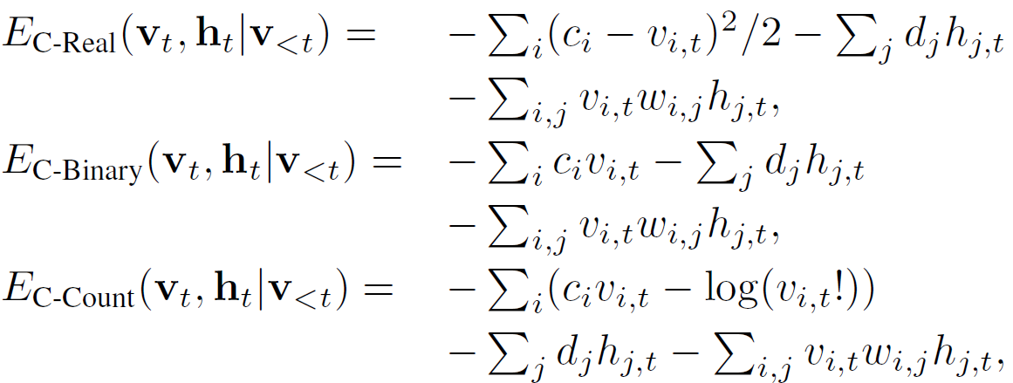
Discriminative Conditional RBM (DCRBM) aka hybrid model
LABEL
y
HIDDEN
h
v_{hist}
v
HISTORY
VISIBLE
Shortcomings:
Distribution assumptions
Fixed window history
Approximate loss function
Training with Gibbs Sampling

Slide 21
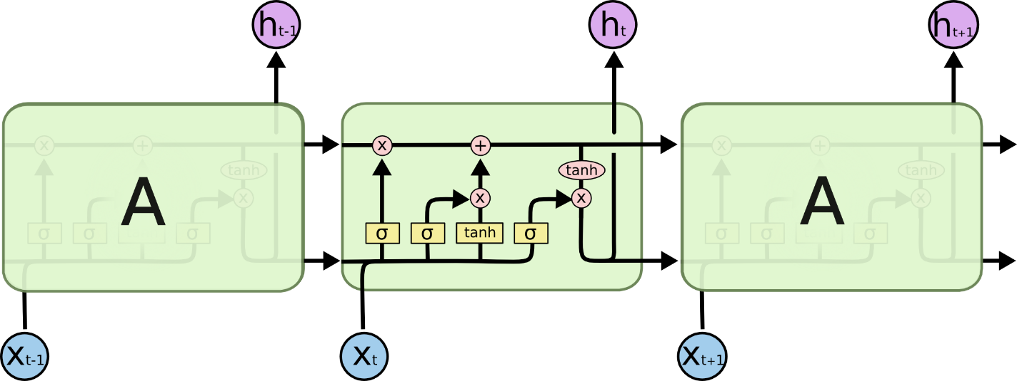
Long Short Term Memory (LSTM)

Slide 22
Long Short Term Memory (LSTM)
“forget gate”

Slide 23
Long Short Term Memory (LSTM)
“input gate”

Slide 24
Long Short Term Memory (LSTM)

Slide 25
Long Short Term Memory (LSTM)

Slide 26
Outline
Broad goal: Provide process monitoring, quality control and analytics at the hardware level. Why?
Activity Recognition: “GPU Activity Prediction using Representation Learning”, Aswin Raghavan, Mohamed Amer, David Zhang, Sek Chai, ICML 2016
Performance Optimization: “Event Prediction in Processors Using Deep Temporal Models”, Tharindu Mathew, Aswin Raghavan, Sek Chai, ASPLOS 2018
Malware detection / Code integrity: “Detecting Zero-day Controller Hijacking Attacks on the Power-Grid with Deep Learning”, Zecheng He, Aswin Raghavan, Sek Chai, Ruby Lee, TrustCom 2019
Source code → Runtime → Execution analytics
Modelling: Deep Temporal Generative Models
Application: Proactive computing for operational efficiency (GPU)
Application: Detecting zero day attacks on power grid controller code (PLC)
Discussion: Applications and Shortcomings

Slide 27
GPU Performance Optimization
Hard to optimize GPU performance
Highly parallelized execution
Local warp execution interacting with global resources
SIMT execution
Goal: Predict Salient Events that affect performance
Example, Cache miss events
Instruction Cache Read/Write Cache
Data Cache Read/Write Cache
Cache miss is expensive
Synchronize with global L2 cache
Write back to global memory
Wait cycles
Predicting Cache miss is useful
Prefetching
Profiling code

Slide 28
The Data
Data can be collected from program execution. Expensive!
We use a cycle-level simulator: GPGPU-Sim
Can simulate different GPU models
We use the simulator to generate HPC-like data
GPGPU-Sim also collects the salient events
Binary labels for each cycle
Labels: Predict whether a failure will occur within next T cycles
For example, y = 1 at time t, if cache miss occurs in [t,t+128] cycles
Data is collected across multiple workloads from benchmarks
We used RODINIA benchmarks
NVIDIA releases their own benchmark

Slide 29
Use Case for NVIDIA GPUs
Input high level code w/ warp Instructions
Conversion to PTX : low level thread instructions
bpnn_layerforward_CUDA<<< grid, threads >>>(input, output … );
bpnn_adjust_weights_cuda<<< grid, threads >>>(hidden, input, …);
prinint kernel _Z24bpnn_adjust_weights_cudaPfiS_iS_S_
PC=0x318 (_1.ptx:206) ld.param.s32 %r1, …
PC=0x320 (_1.ptx:207) add.s32 %r2, %r1, 1;
…
prinint kernel _Z22bpnn_layerforward_CUDAPfS_S_S_ii
PC=0x000 (_1.ptx:67) cvt.s32.u32 %r1, %tid.x;
PC=0x008 (_1.ptx:68) mov.s32 %r2, 0;
...

Slide 30
HPC Extraction for NVIDIA GPUs
Multiple instances of the same instruction running in parallel
prinint kernel adjust_weights
PC=0x318 (_1.ptx:206) ld
PC=0x320 (_1.ptx:207) add
PC=0x328 (_1.ptx:208) mul
PC=0x330 (_1.ptx:209) cvt
…
PC=0x3f8 (_1.ptx:234) ld
PC=0x400 (_1.ptx:235) cvt
PC=0x408 (_1.ptx:236) ld
…
PC=0x470 (_1.ptx:249) st
PC=0x478 (_1.ptx:251) ld
…
PC=0x4e0 (_1.ptx:265) bar
PC=0x4f0 (_1.ptx:267) set
PC=0x4f8 (_1.ptx:268) neg
...
T=250, Begin 0x318, 0x320
T=251, Begin 0x318, 0x320
T=270, End 0x318, 0x318
Begin 0x318, 0x320
0x320, 320
…
T=300, End 0x320, 0x328, 0x318 Begin 0x328, 0x330, 0x320
T=250, {add:1, ld:5, mov:2, mul:3}
T=260, {add:10, mul:8}
--- compute activity
T=270, {st:10, cvt:8}
--- store activity
SIMULATOR
HISTOGRAM/BAG
OF INSTRUCTIONS
61 DIMENSIONS

Slide 31
Event Detection Model
c
LABEL
y
BINARY ~ Bernoulli( σ(C^{T}h+c) )
C
HIDDEN
b
h
TERNARY [-2,2] ~ 2*Binomial(n=2,σ(B^{T}v_{hist}+W^{T}v+C^{T}y+b))-2.
B
W
A
v_{hist}
v
COUNT ~ Poisson( exp(A^{T}v_{hist}+W^{T}h+a) )
HISTORY
VISIBLE
COUNT ~ Poisson
a

Slide 32
Event Detection Model
LABEL
y
HIDDEN
b
h
B
w
A
v_{hist}
v
HISTORY
VISIBLE
a

Slide 33
Dealing With Unbalanced Data
LABEL
y
HIDDEN
b
h
B
Cache miss events are infrequent (~0.1% of the data).
Scale the error terms above as a function of class label Q(y).
We set Q(y) = 0.5/(frequency of y in the data).
w
A
v_{hist}
v
HISTORY
VISIBLE
a

Slide 34
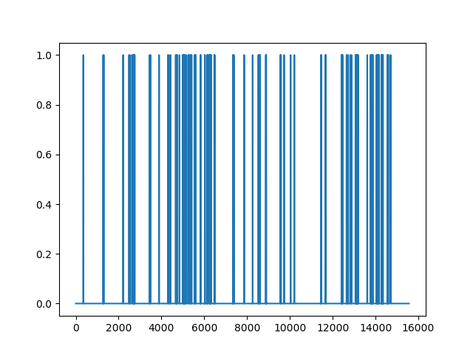
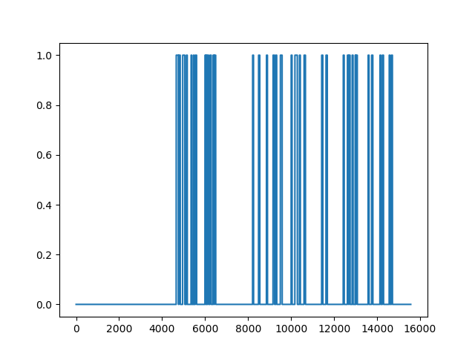
After 50k Epochs : Predictive Accuracy
Ground Truth
Prediction

Slide 35
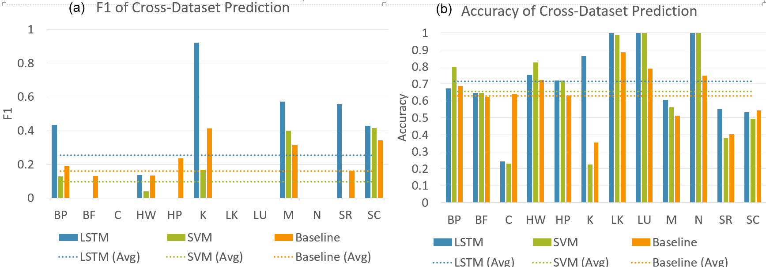
Transfer Learning across different workloads
2048 Neurons (0.5 Dropout)
2048 Neurons (0.5 Dropout)
2048 Neurons (0.5 Dropout)
2048 Neurons (0.5 Dropout)
Sigmoid Layer
Probability of Cache Miss
Instruction Sequence
For our Deep Temporal model, we use 2048-neuron LSTM cell in 4 successive layers
To improve regularization, a dropout ratio of 0.5 used
A sigmoid layer outputs the probability of a cache miss
A threshold of 0.5 is applied to create a binary output that represents the cache miss

Slide 36
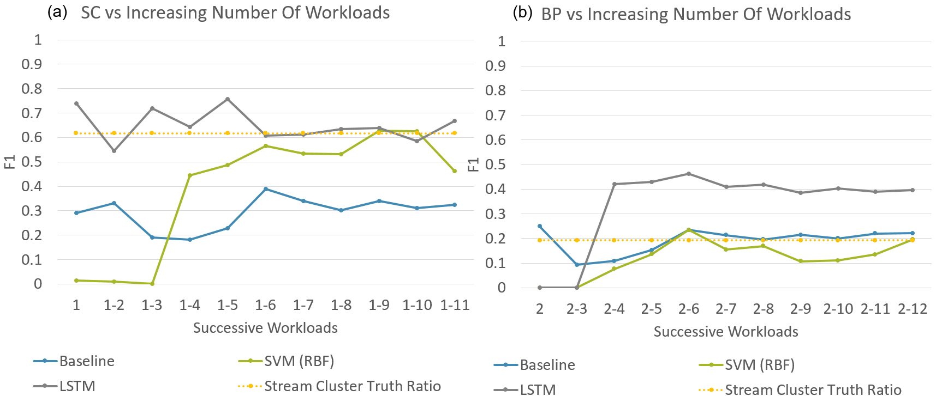
Transfer Learning across different workloads
2048 Neurons (0.5 Dropout)
2048 Neurons (0.5 Dropout)
2048 Neurons (0.5 Dropout)
2048 Neurons (0.5 Dropout)
Sigmoid Layer
Probability of Cache Miss
Instruction Sequence
For our Deep Temporal model, we use 2048-neuron LSTM cell in 4 successive layers
To improve regularization, a dropout ratio of 0.5 used
A sigmoid layer outputs the probability of a cache miss
A threshold of 0.5 is applied to create a binary output that represents the cache miss

Slide 37
Outline
Broad goal: Provide process monitoring, quality control and analytics at the hardware level. Why?
Activity Recognition: “GPU Activity Prediction using Representation Learning”, Aswin Raghavan, Mohamed Amer, David Zhang, Sek Chai, ICML 2016
Performance Optimization: “Event Prediction in Processors Using Deep Temporal Models”, Tharindu Mathew, Aswin Raghavan, Sek Chai, ASPLOS 2018
Malware detection / Code integrity: “Detecting Zero-day Controller Hijacking Attacks on the Power-Grid with Deep Learning”, Zecheng He, Aswin Raghavan, Sek Chai, Ruby Lee, TrustCom 2019
Source code → Runtime → Execution analytics
Modelling: Deep Temporal Generative Models
Application: Proactive computing for operational efficiency (GPU)
Application: Detecting zero day attacks on power grid controller code
Discussion: Applications and Shortcomings

Slide 38
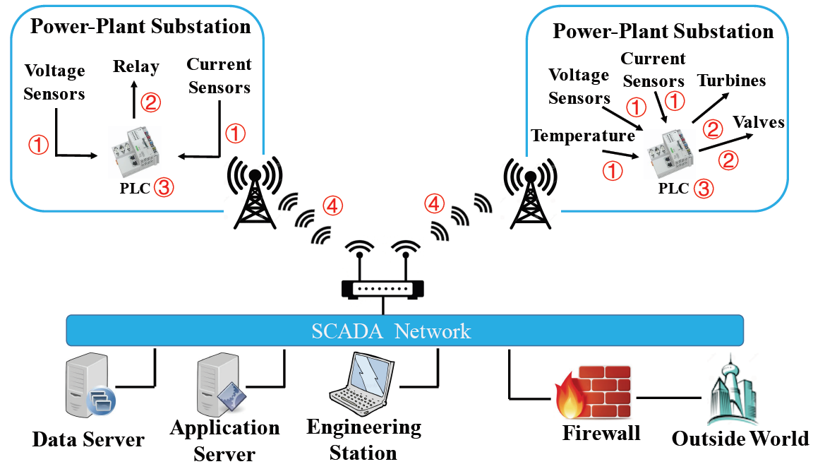
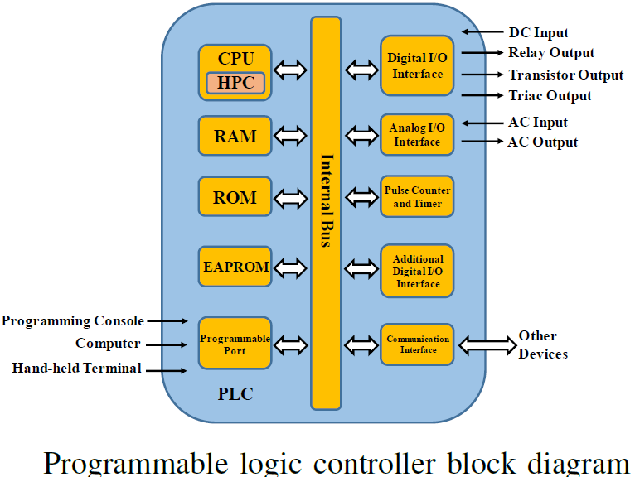
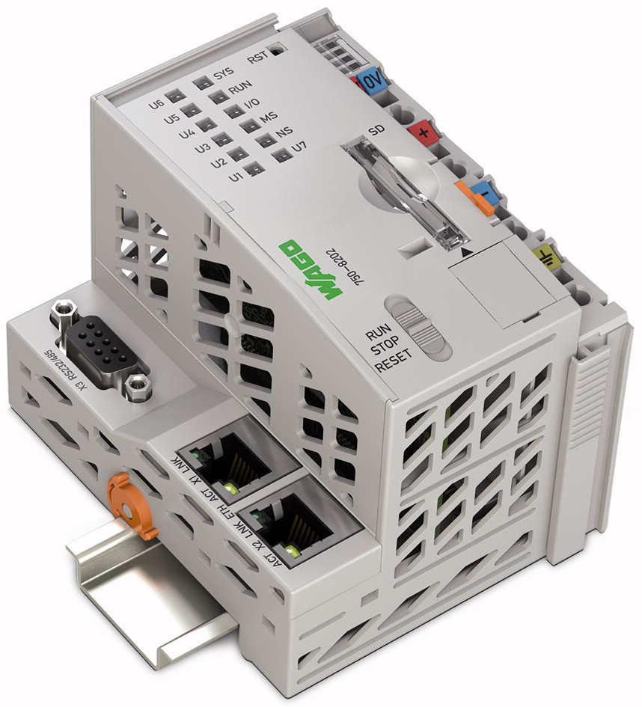
Power Grid Controller : PLC
Attacks can happen in sensors, ­ actuators, controllers and networks
Programmable logic controller (PLC) is a digital device equipped with microprocessors, widely used as the controller in a power-grid subsystem
PLC in our experiments is a Wago PLC with an ARM Cortex A8 processor

Slide 39
Threat Model
Our threat model specifically includes zero-day attacks.
We assume that there is no prior-knowledge of attack code
The goal of the attacker is to hijack the controller and run unauthorized code
Attacker can hijack the controller code, add to, delete or modify
We assume the normal behavior of the controller can be collected in a clean environment and used for training a deep learning model

Slide 40
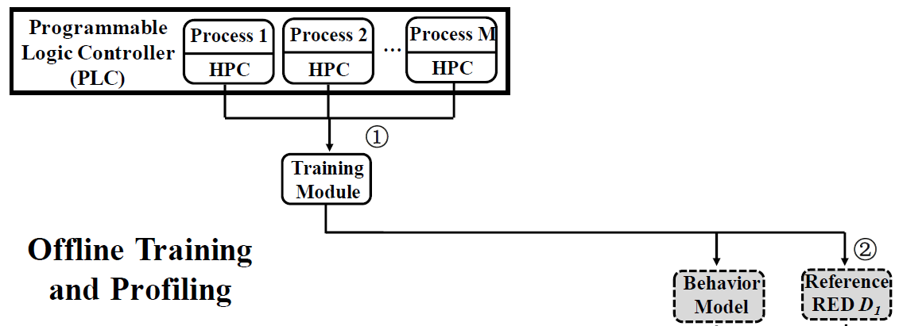
Offline Training
Key idea: normal behavior of the controller in a power-grid system is predictable w/ a temporal deep temporal model and low-cost HPC features
Deviation of the real monitored behavior from the predicted behavior indicates anomalies
Offline training:
Train a deep learning sequence predictor to predict future normal behavior
Calculate reconstruction error
Reference error distribution (RED) is the histogram of reconstruction error

Slide 41
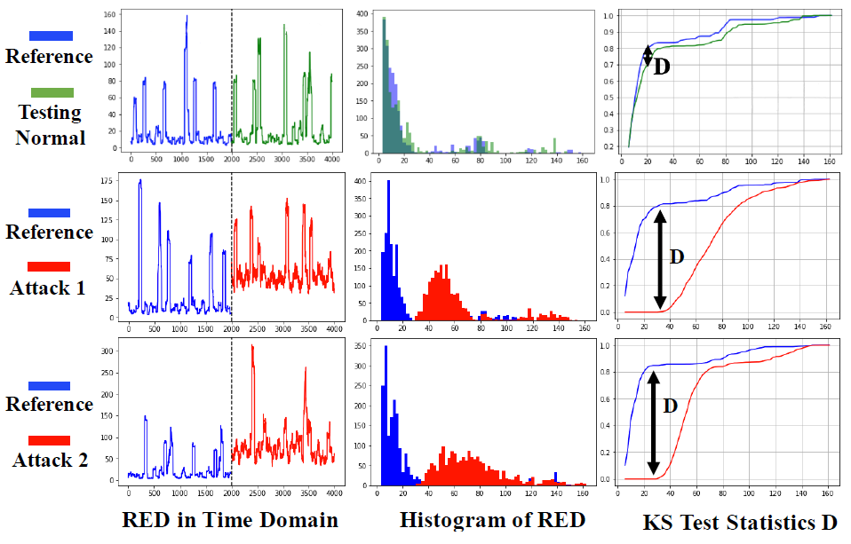
Online Detection
Using the sequence predictor, predict the future behavior conditioned on the historical behavior. This is RED D₂ : normal or abnormal
Apply a distribution-free two-sample test for D₁ and D₂ coming from the same distributions – we use a K-S test here

Slide 42
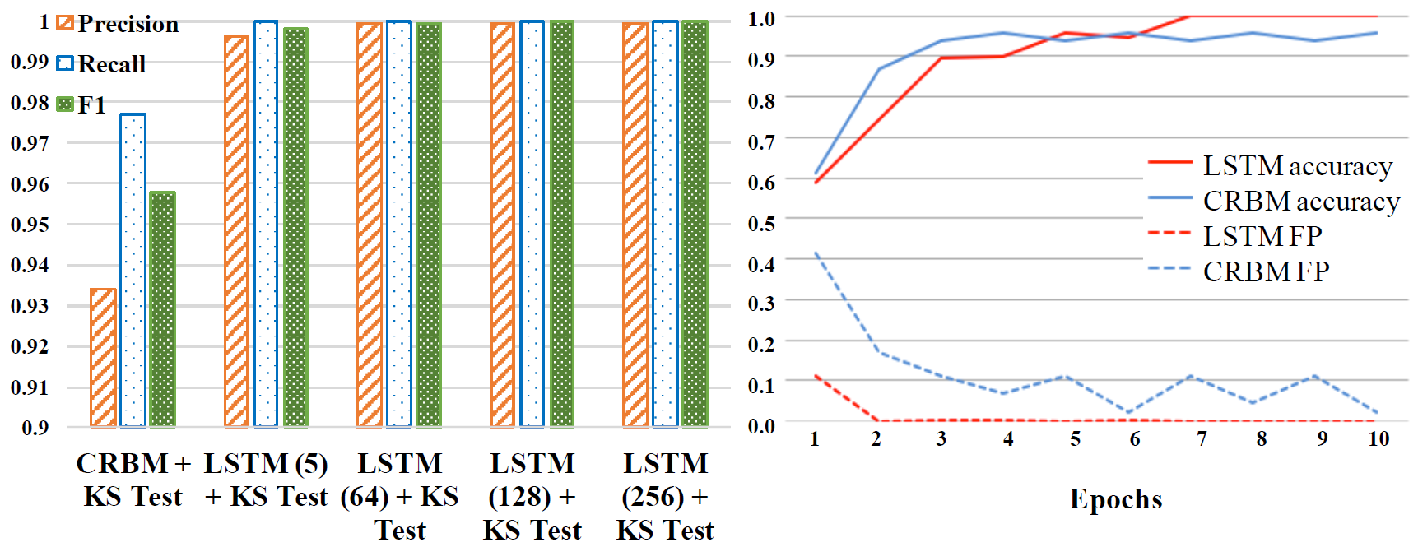
Experimental Results – Attack Detection

Slide 43
Experimental Results – To deep or not to deep?

Slide 44
Discussion
HPC provide a tamper-resistant and low-cost way to monitor the processors and controllers
Many Do’s and Don’ts for using HPC^{1,2}
HPC ideal for PLC – hardware execution without VMs
End of the day, it is just one modality of input for training
Extremely fast! Suitable for online use on the chip!
Deep temporal models work very well for event/hijacking detection
Better than non-deep models, directly using HPC
Better than non-temporal models
LSTM avoid distribution assumption and fixed window size
But performance of DCRBM is comparable (slightly worse)
Idea of RED helps F-1 score a little bit (by about 7 points: 93.2 to 1.00)
Other 2-sample tests can be used e.g. MMD

Slide 45
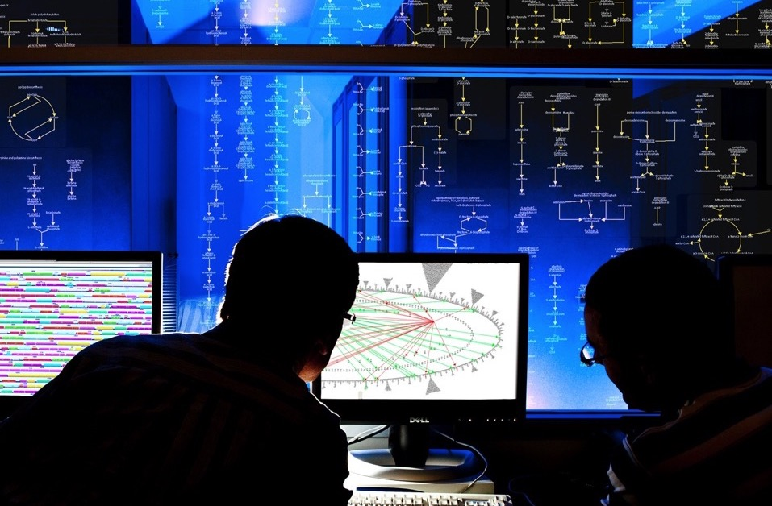
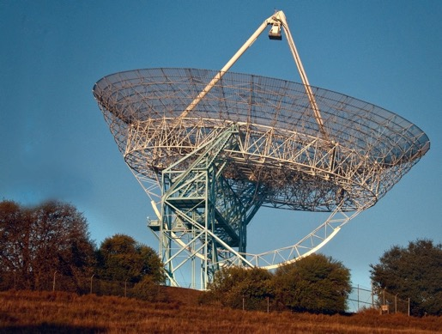
SRI’s Mission:
create world changing solutions making people safer, healthier, and more productive
Not-for-profit: Return on investment is measured by impact, not dollars
Science-focused: Build on technology platforms to fill gaps in customer needs
Multidisciplinary: Breadth and depth to solve the hardest problems
Perspective: Located in the heart of silicon valley, 100s of partners around the globe

Slide 46
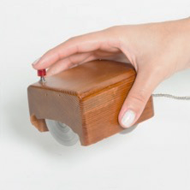
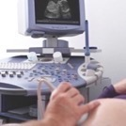
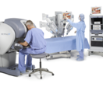
What We Do
R&D
PROJECTS
SRI’s research and development:
Information and computing
Biosciences
Materials
Education
Robotics, Sensors and Systems
Multidisciplinary R&D
LICENSING
&
PRODUCTS
GLOBAL PARNERSHIPS
NEW
VENTURES
You use SRI innovations every day
New drug for lymphoma
First computer mouse
Created Siri
(acquired by Apple)
First robotic
surgical system
Ultrasound imaging for
medical diagnostics
First ARPANET and internetworking nodes
Vision technologies
(HDTV, Color TV, etc.)

Slide 47
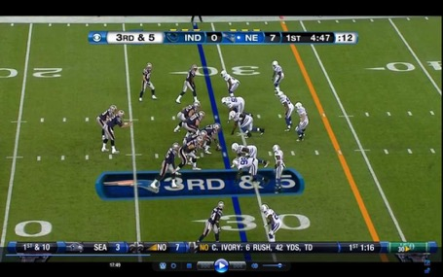
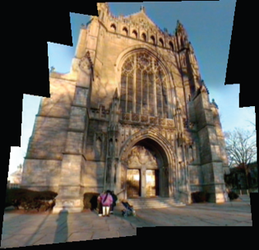
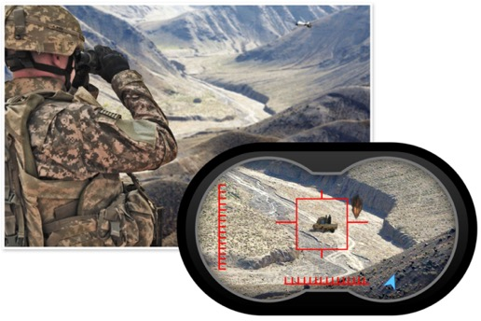
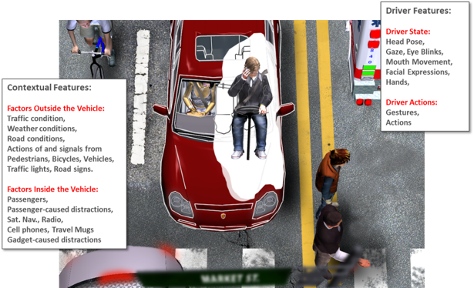
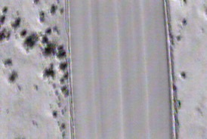
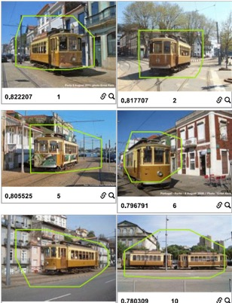
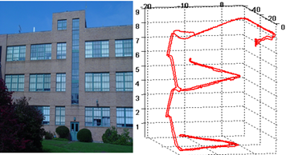
SRI Center for Vision Technologies
90 staff
30 year history in Real Time Computer Vision
150+ patents
First real time AR broadcast on live TV 1994:1st down line in football
VideoBrush: First ever live Video Mosaicing
First ever Augmented Reality binoculars
IED Detection
Currently saving lives
Driver State Monitoring
Human Behavior Modeling
Real-time airborne object tracking
Live traffic Monitoring, deployed all over the country
GPS Denied Navigation
Navigation and Mapping
Search in image/video

