Slide 1
Web Scraping-Natural Language Processing (NLP) for Disease Outbreak Detection and Information Extraction
Yijun Wei, NISS-NASS
Luca Sartore, NISS-NASS
Nell Sedransk, NISS-NASS
Gavin Corral, USDA-NASS
Emilola Abayomi, USDA-NASS

Slide 2
Disclaimer
The findings and conclusions in this presentation are those of the author and should not be construed to represent any official USDA or U.S. Government determination or policy.

Slide 3
Outline
Background
Purpose
Approach:
Stage 1: Disease outbreak detection
Stage 2: Web scraping-Natural Language Processing (NLP) approach
Named Entity Recognition (NER) and Information Extraction (IE)
Stage 2.1: Hybrid approach
Definition
Case study
Stage 2.2 to improve Stage 2.1: Pre-training of Deep Bidirectional Transformers for Language Understanding (BERT)
Definition
Case study on NER
4. Conclusion
5. Potential for information

Slide 4
Outline
Background
Purpose
Approach:
Stage 1: Disease outbreak detection
Stage 2: Web scraping-Natural Language Processing (NLP) approach
Named Entity Recognition (NER) and Information Extraction (IE)
Stage 2.1: Hybrid approach
Definition
Case study
Stage 2.2 to improve Stage 2.1: Pre-training of Deep Bidirectional Transformers for Language Understanding (BERT)
Definition
Experiment on NER
4. Conclusion
5. Potential for the information

Slide 5
Background
NASS annually publishes estimates of US Hogs – Quarterly Hog Inventory National Numbers using statistical models
Models only capture equilibrium picture but cannot detect unusual pattern such as disease outbreak
The impact of disease can be substantial, but initial event can be local and/or small
Detection of the early stages is challenging
Current diagnostics lag the occurrence of the outbreak by a quarter
A preliminary study depended on the hybrid NLP approach with limited training data

Slide 6
Goals for two stages Web scraping-NLP approach
Stage 1 - Web scraping
Goal: Hog disease outbreak rapid detection
Application
Timely report for the disease outbreak
Stage 2 - Web scraping - NLP
Goal: Information summary from scraped news
Application of information summary
Geo-locating the outbreak
Better precision in predicting pattern and rate of spread of the disease
Documentation of the disease on each scale national-state-local with limited training data
Input to spatial-epidemic model
Data prepared for experts

Slide 7
Stage 1 - Web scraping Hog Disease Outbreak Detection
Goal
Detect whether the disease outbreak happens using web scraping
Tools
1. Web scraping in Swine Disease Global Surveillance Project (SDGSP)
University of Minnesota Swine Center
Monitors hog disease outbreaks on international scale
Publishes reports every two weeks

Slide 8
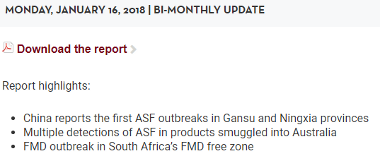
African Swine Fever Outbreak: China

Slide 9
More Web scraping Sources
2. Disease Report Repositories
APHIS (USDA)
3. Media sources
News feeds – national, state, local
Extension service websites
Producers’ organizations websites
Blogs

Slide 10
Outline
Background
Purpose
Approach:
Stage 1: Disease outbreak detection
Stage 2: Web scraping-Natural Language Processing (NLP) approach
Named Entity Recognition (NER) and Information Extraction (IE)
Stage 2.1: Hybrid approach
Definition
Case study
Stage 2.2 to improve Stage 2.1: Pre-training of Deep Bidirectional Transformers for Language Understanding (BERT)
Definition
Experiment on NER
4. Conclusion
5. Potential for the information

Slide 11
Stage 2: Web scraping-Natural Language Processing (NLP)
Step 1. Web scraping for news resources
Multiple hog domain websites:
The Pig Site (https://thepigsite.com/)
National Hog Farms (https://www.nationalhogfarmer.com/)
Step 2. NLP for information summary
Summarize information from the web-scraped news with the help from two NLP tasks:
Named Entity Recognition (NER)
Information Extraction (IE)

Slide 12
Named Entity Recognition (NER) and Information Extraction (IE)
Named entities (NE): definite noun phrases that refer to specific types of nouns
NER: identify all mention of NEs
IE: Identify structured relationships between NEs
Example:
The Ministry of Agriculture and Rural Affairs said the first outbreak is on a farm in the Xushui district of Baoding city
NER: Ministry of Agriculture and Rural Affairs, outbreak, Xushui district of Baoding city
IE: Ministry of Agriculture and Rural Affairs said the first outbreak
outbreak is on a farm in the Xushui district of Baoding city

Slide 13
Natural Language Processing (NLP) approaches overview
Rule-based
A hand-crafted system of rules based on linguistic structures that imitates the human
Eg: In NER, word shape feature, a word initialed with capitalized character, such as China, United States, etc … or a word with the format X.X.X, such as I.M.F
“Traditional” machine learning
Based on algorithms that learn to “understand” language without being explicitly programmed:
probabilistic modeling, likelihood maximization, and linear classifiers
Engineer features
Split the dataset into training data, and test data
Training a model on parameters, followed by testing on test data
Inference
Hybrid approach = 1+2

Slide 14
Stage 2.1: Hybrid approach
As soon as a hog disease outbreak is detected:
Step 1: Related news will be scraped from the website
Step 2: Information will be extracted from related news, using a hybrid approach
1. Normalize time
Different temporal formats transformed to a single form
2. Normalize word
Different word formats converted to a singular form
3. Keywords defining
Keywords are defined, eg: “outbreak”, “African Swine Fever”
4. Named Entity Recognition
Recognize the Named Entities
5. Information extraction
Extract pertinent information between Named entities

Slide 15
Application of the hybrid approach – Case study
Input, News item web-scraped from The Pig Site
'The Ministry of Agriculture and Rural Affairs said the first outbreak is on a farm in the Xushui district of Baoding city which has 5,600 hogs, some of which died because of the swine fever, though it did not provide a death toll.
The farm has been quarantined and the herd slaughtered, it added.

Slide 16
Application of the hybrid approach – Case study
Reuters reports that the second outbreak is in the remote Greater Khingan Mountains in Inner Mongolia, where 210 of the 222 wild boar raised on the farm died, the ministry said in a separate statement. The rest have been slaughtered, it said.
China has reported more than 100 cases of African swine fever in 27 provinces and regions since last August. The disease is deadly for pigs but does not harm humans.'

Slide 17
Case study specific steps
Normalize word:
Raised to raise
Slaughtered to slaughter
Quarantined to quarantine
Keyword define:
“outbreak”
Named Entity Recognition:
Ministry of Agriculture and Rural Affairs
Xushui district of Baoding city
Swine fever

Slide 18
Case study result
4. Information extraction, and result:
1. 'outbreak', Source: Ministry of Agriculture and Rural Affairs', Location: Xushui district of Baoding city', Stats: 5,600'
2. 'outbreak', Source: 'Reuters', Location: 'remote Greater Khingan Mountains in Inner Mongolia', Stats: '210 of the 222 died'

Slide 19
Hybrid approach drawbacks
Task specific for each disease and country
“Reporting it wouldn't have made a difference, he said, standing outside his farm in xijiahe, a village in China's Shandong province.”
Time consuming for coding rules
Corpus is not comprehensive
News from only a few hog news websites are scraped

Slide 20
Outline
3. Approach:
Stage 1: Disease outbreak detection
Stage 2: Web scraping-Natural Language Processing (NLP) approach
Named Entity Recognition (NER) and Information Extraction (IE)
Stage 2.1: Hybrid approach
Definition
Case study
Stage 2.2 to improve Stage 2.1: Pre-training of Deep Bidirectional Transformers for Language Understanding (BERT)
Definition
Experiment on NER
4. Conclusion
5. Potential for the information

Slide 21
NLP approaches overview- Continue
3. Hybrid approach = Rule-based + “Traditional” machine learning
4. Deep learning
Feature engineering is skipped, as networks will "learn" important features
Streams of raw parameters (words) without engineered features, are fed into networks
Large training corpus (dataset)
Semi-supervised deep learning
Only small number of training instances are available
Pre-trained on billion records corpus
Fine-tuned to domain adaption
(Jurafsky and Martin, 2014; Goldberg, 2017)

Slide 22
Stage 2.2: Semi-supervised deep learning network Overview
Designed to improve Stage 2.1, hybrid approach
1. Increase the number of scraped news sites
Streaming news API
Collect related news from hundreds of thousand web sources
2. Improve the efficiency of the hybrid approach with limited training data
Semi-supervised deep learning network
Pre-training of Deep Bidirectional Transformers for Language Understanding (BERT)

Slide 23
Pre-training of Deep Bidirectional Transformers for Language Understanding (Bert) Overview
One of the breakthrough in NLP in 2018, and outperforms all other models on various tasks
Pre-trained by Google AI Language on a large amount of text data, 3.3B words for 40 epochs
Can be fine-tuned on small data NLP task such as NER, and IE
Transfer learning from Human (also in computer vision)
Words are embedded based on both themselves and their neighborhood words
Word embedding: a word represented by a vector
Eg: run -> (0.2, 0.1, …, 0.3)

Slide 24
Case study
Fine-tune BERT to NER:
The Bert is pre-trained first
Adding a classification layer to task 2
News scraped from streaming news API
Corpora: 20 training text news + CoNLL03
Trained 5 epochs, and tested on 20 text news
Finished within 0.5 hour on a GTX 1070 GPU

Slide 25
Case study - Training dataset
Corpora (training dataset):
CoNLL 2003: Dataset that contains 1,393 English news articles with annotated entities LOC (location), ORG (organization), PER (person) and MISC (miscellaneous)
Text news: News article scraped from streaming news API using keywords “African Swine Fever”, and hand tagged the same as CoNLL 2003
Using I (inside) - O (outside) - B (Begin), Each word is tagged with one of special chunk tags

Slide 26
Case study
Input
The Ministry of Agriculture and Rural Affairs said the first
outbreak is on a farm in the Xushui district of Baoding
city which has 5,600 hogs, some of which died because of the
swine fever, though it did not provide a death toll.
Output
The Ministry of Agriculture and Rural Affairs said the first
O B-LOC I-LOC I-LOC I-LOC I-LOC I-LOC O O O
outbreak is on a farm in the Xushui district of Baoding
B-MISC O O O B-LOC I-LOC I-LOC I-LOC I-LOC I-LOC I-LOC
city which has 5,600 hogs, some of which died because of the
I-LOC O O B-MISC O O O O O O O O swine fever, though it did not provide a death toll.
I-MISC I-MISC O O O O O O O O

Slide 27
Case study Evaluation metrics, Result
Confusion Matrix
 | True condition
Predicted Condition | Total population | Condition Positive | Condition Negative
 | Predicted Positive | True Positive (TP) | False Positive (FP)
 | Predicted Negative | False Negative (FN) | True Negative (TN)
F1 score: Precision*Recall/(Precision+Recall)
where: Precision = TP/(TP+FN)
Recall = TP/(TP+FP)
BERT Reached test F1 score 0.81

Slide 28
Case study - an example - Continued
 | Confidence | Tag
Reuters | 99% | B-ORG
reports | 99% | O
that | 99% | O
the | 99% | O
second | 99% | O
outbreak | 99% | O
is | 99% | O
In | 99% | O
 | Confidence | Tag
in | 99% | O
the | 99% | O
remote | 99% | B-LOC
Greater | 99% | I-LOC
Khingan | 99% | I-LOC
Mountains | 99% | I-LOC
in | 99% | O
Inner | 99% | B-LOC
Mongolia | 99% | I-LOC
, | 99% | O

Slide 29
Case study - an example
 | Confidence | Tag
where | 99% | O
210 | 99% | B-MISC
of | 99% | O
the | 99% | O
222 | 99% | B-MISC
wild | 99% | O
boar | 99% | O
raised | 99% | O
on | 99% | O
the | 99% | O
 | Confidence | Tag
farm | 99% | O
died | 99% | O
, | 99% | O
the | 99% | O
ministry | 99% | O
said | 99% | O
in | 99% | O
a | 99% | O
separate | 99% | O
statement | 99% | O
. | 99% | O

Slide 30
Conclusion
Using BERT accelerates the process
More Corpora and training instances are needed for BERT to achieve better F1 score
BERT should be used for Information Extraction (IE) to summarize information from scraped news
The entire process is still in a very early stage, and more work should be done
More sources should be used for hog disease detection

Slide 31
Potential for information
Time and location of disease references:
1. Fine scale (state, county) incidence allowing spatial disease modeling and mapping
2. Time course of spread
3. External documentation confirming disease and response to outbreak
4. Data for other experts
5. Information to incorporate into the model system

Slide 32
Reference
Bird, S., Klein, E., & Loper, E. (2009). Natural language processing with Python: analyzing text with the natural language toolkit. " O'Reilly Media, Inc.".
Devlin, J., Chang, M. W., Lee, K., & Toutanova, K. (2018). Bert: Pre-training of deep bidirectional transformers for language understanding. arXiv preprint arXiv:1810.04805.
Goldberg, Y. (2017). Neural network methods for natural language processing. Synthesis Lectures on Human Language Technologies, 10(1), 1-309.
Jurafsky, D., & Martin, J. H. (2014). Speech and language processing (Vol. 3). London: Pearson.
Sarawagi, S. (2008). Information extraction. Foundations and Trends® in Databases, 1(3), 261-377.
Vaswani, A., Shazeer, N., Parmar, N., Uszkoreit, J., Jones, L., Gomez, A. N., ... & Polosukhin, I. (2017). Attention is all you need. In Advances in neural information processing systems (pp. 5998-6008).
Wei, Y., Sartore, L., Miller, D., Abernethy, J., Toppin, K., & Hyman, M. (2018). Deep learning for Data Imputation and Calibration Wighting. In JSM Proceedings, Statistical Computing Section. Alexandria, VA: American Statistical Association.

Slide 33
Questions?

Slide 34
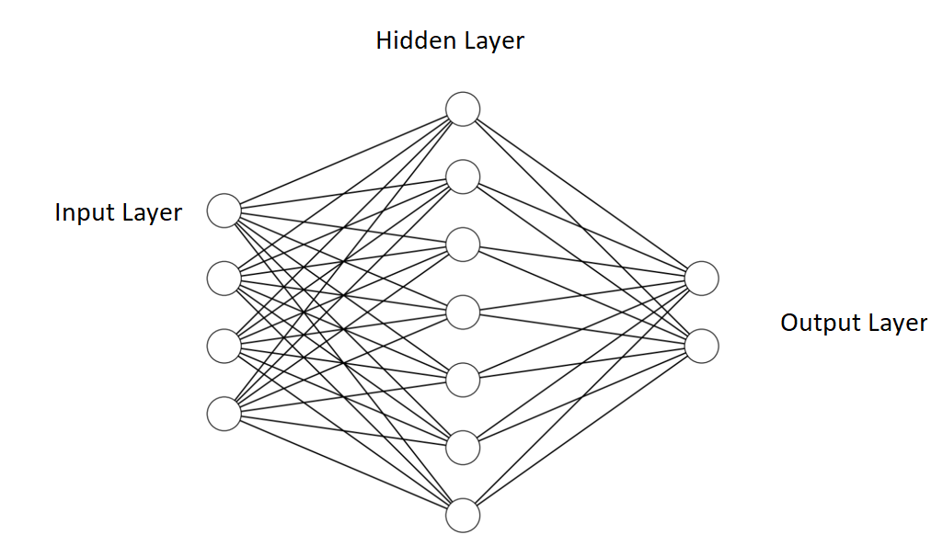
Artificial Neural Network (ANN)
Structure of ANN (Wei et al., 2018)
Notes:
A simple ANN consists of 3 components, i.e. input layer, hidden layer, and output layer
In the figure, one hidden layer is located between the input layer and output layer. There can be multiple hidden layers in an ANN but they are of the same form.
A hidden layer consists of several neurons and these neurons are used to form output layer. The information stored in the hidden neurons is computed as a sigmoid function of a linear combination based on the input variables plus a constantand the math form is:
The formula
where $i$ represents the $i$-th hidden neuron, j represents j-th input, $w_{ji}$ represents weight in i-th neuron j-th input component, $b_{i}$ represents bias in i-th neuron, ${Input}_{j}$ represents the $j$-th component, i.e. observation, of input layer, and $σ$ is the activation function and is always set as sigmoid function.
The formula
The definition of letters are pretty the similar as the above except activation function is set as the softmax function.
Weight $w$ and $b$ will be randomly initialized and backpropagation will be used to update weights and biases.
The information on the output neurons consist of a soft max function applied to a linear combination based on the hidden values plus another constant. The parameters are randomly initialized and updated through back-propagation.

Slide 35
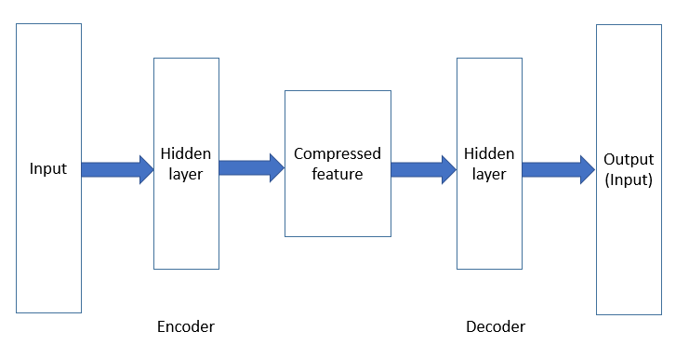
Auto-encoder
Auto-encoder is a type of ANN that is trained to attempt to copy its input to its output
Structure of Auto-encoder(Wei et al., 2018)
Notes:
Anautoencoder is a neural network that is trained to attempt to copy its input to its output. Internally, it has a hidden layer that describes a code used to represent the input. The network may be viewed as consisting of two parts: an encoder represents a feature extracted process and a decoder that produces an input reconstruction.This architecture is presented in ﬁgure.

Slide 36
Transformer - Overview
With sequence-to-sequence architecture, a neural net that transforms a given sequence of words in a sentence, into another sequence
An encoder that reads the text input and a decoder that produces a prediction for the task
The attention-mechanism focuses on an input sequence and decides at each step which other parts of the sequence are important (Vaswani et al., 2017)
Q&A task in NLP,
Text: It was sunny yesterday, so we were playing basketball
Q: What sport did we play yesterday?
A: We were playing basketball

Slide 37
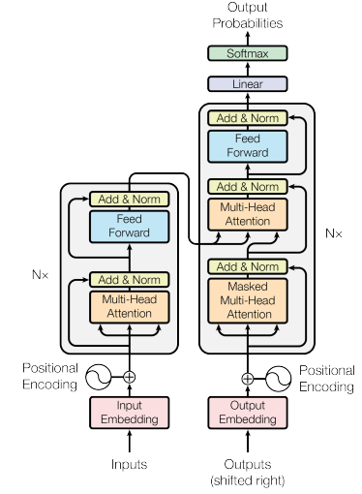
Transformer - Structure
The Transformer – Architecture (Vaswani et al., 2017)
Notes:
The Encoder is on he left and the Decoder is on the right. Both Encoder and Decoder are composed of modules that can be stacked on top of each other multiple times, which is described by Nx in the figure. We see that the modules consist mainly of Multi-Head Attention and Feed Forward layers. The inputs and outputs (target sentences) are first embedded into an n-dimensional space since we cannot use strings directly.
One slight but important part of the model is the positional encoding of the different words. Since we have no recurrent networks that can remember how sequences are fed into a model, we need to somehow give every word/part in our sequence a relative position since a sequence depends on the order of its elements. These positions are added to the embedded representation (n-dimensional vector) of each word.

Slide 38
BERT - details
With two tasks:
Task1: Mask 15% of the input to use as output by stacking multiple Transformer encoders
Task 2: Input: pairs of sentences; Output: predict whether the output of the sentence is the subsequent sentence in the original text using Transformer network
Minimize the combined loss function

Slide 39
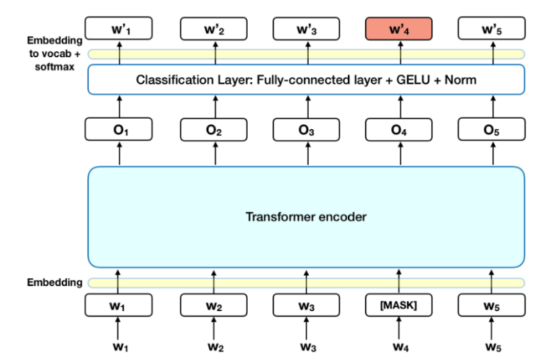
BERT Structure
Task 1: Masked LM (Devlin et al., 2018)
Notes:
Before feeding word sequences into BERT, 15% of the words in each sequence are replaced with a [MASK] token. The model then attempts to predict the original value of the masked words, based on the context provided by the other, non-masked, words in the sequence. In technical terms, the prediction of the output words requires:
Adding a classification layer on top of the encoder output.
Multiplying the output vectors by the embedding matrix, transforming them into the vocabulary dimension.
Calculating the probability of each word in the vocabulary with softmax.
The BERT loss function takes into consideration only the prediction of the masked values and ignores the prediction of the non-masked words. As a consequence, the model converges slower than directional models, a characteristic which is offset by its increased context awareness (see Takeaways #3).
Note: In practice, the BERT implementation is slightly more elaborate and doesn’t replace all of the 15% masked words.

Slide 40
BERT Structure - Continue
Task 2: Next sentence prediction (Devlin et al., 2018)
Notes:
In the BERT training process, the model receives pairs of sentences as input and learns to predict if the second sentence in the pair is the subsequent sentence in the original document. During training, 50% of the inputs are a pair in which the second sentence is the subsequent sentence in the original document, while in the other 50% a random sentence from the corpus is chosen as the second sentence. The assumption is that the random sentence will be disconnected from the first sentence.
To help the model distinguish between the two sentences in training, the input is processed in the following way before entering the model:
A [CLS] token is inserted at the beginning of the first sentence and a [SEP] token is inserted at the end of each sentence.
A sentence embedding indicating Sentence A or Sentence B is added to each token. Sentence embeddings are similar in concept to token embeddings with a vocabulary of 2.
A positional embedding is added to each token to indicate its position in the sequence. The concept and implementation of positional embedding are presented in the Transformer paper.
To predict if the second sentence is indeed connected to the first, the following steps are performed:
The entire input sequence goes through the Transformer model.
The output of the [CLS] token is transformed into a 2×1 shaped vector, using a simple classification layer (learned matrices of weights and biases).
Calculating the probability of IsNextSequence with softmax.
When training the BERT model, Masked LM and Next Sentence Prediction are trained together, with the goal of minimizing the combined loss function of the two strategies.

